Slide 1
Switching
Copyright © The McGraw-Hill Companies, Inc. Permission required for reproduction or display.

Slide 2
Figure 8.1 Switched network
A switched network consists of a series of interlinked nodes, called switches.
Switches are devices capable of creating temporary connections between two or more devices linked to the switch.
In a switched network, some of these nodes are connected to the end systems (computers or telephones, for example).

Slide 3
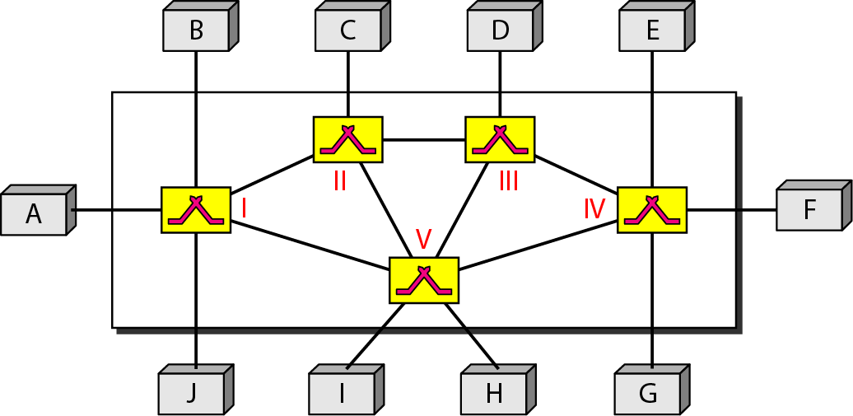
Figure 8.1 Switched network

Slide 4
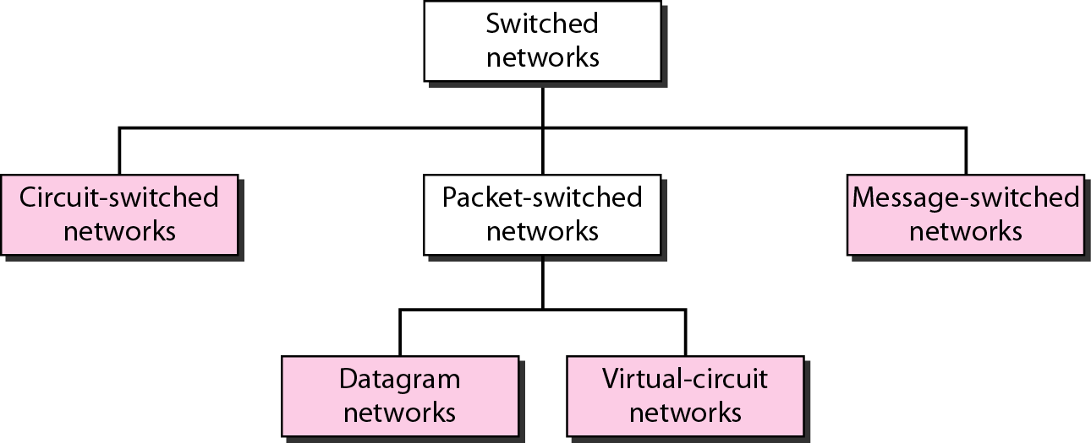
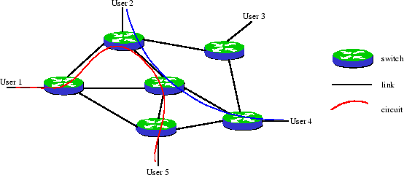
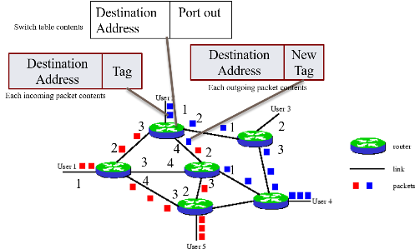
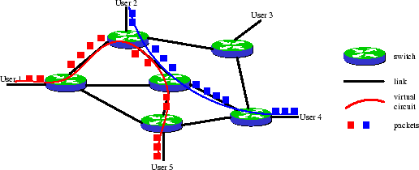
Figure 8.2 Taxonomy of switched networks

Slide 5
8-1 CIRCUIT-SWITCHED NETWORKS
A circuit-switched network is made of a set of switches connected by physical links, in which each link is divided into n channels. Each link is normally divided into n channels by using FDM or TDM.
Establish
Transfer
Disconnect

Slide 6
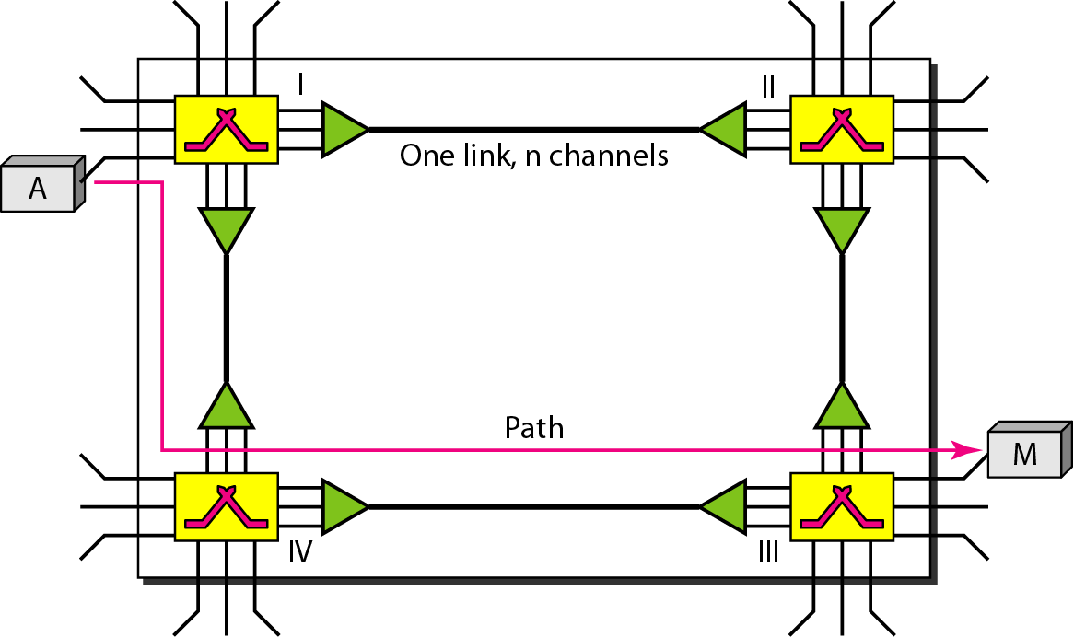
Figure 8.3 A trivial circuit-switched network
Notes:
1.Phy layer
2.

Slide 7

Note
In circuit switching, the resources need to be reserved during the setup phase; the resources remain dedicated for the entire duration of data transfer until the teardown phase.
Not efficient

Slide 8
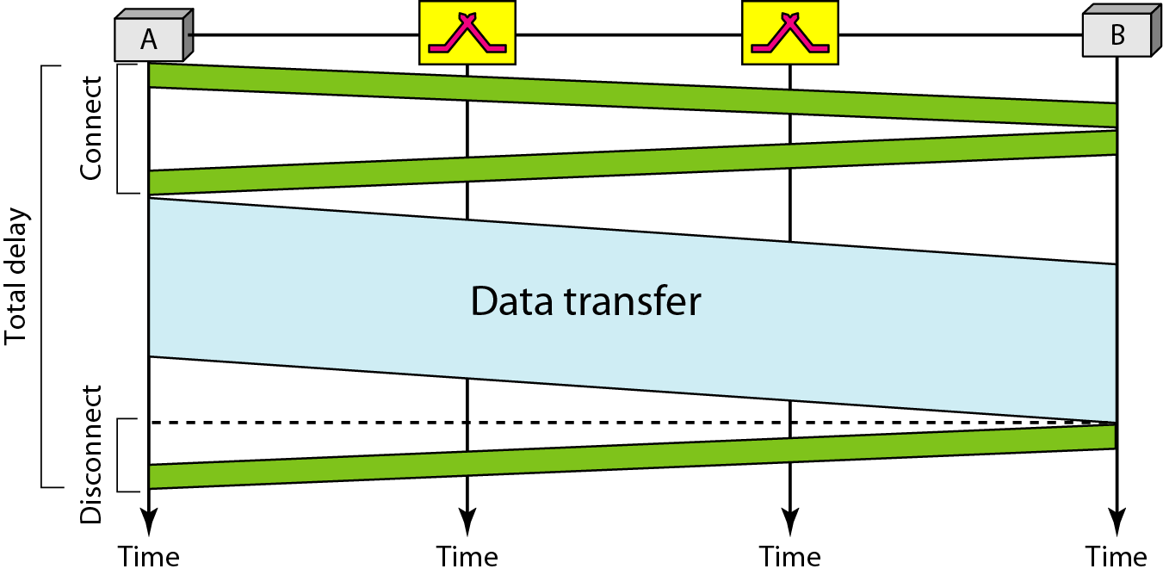
Figure 8.6 Delay in a circuit-switched network

Slide 9
Total Delay for Circuit Switched Network
Transmission Delay, T & Propagation Delay, P
Setup time, ST= Req Pkt +Ack Pkt
Setup time, ST= T_{s}+P_{s}+ T_{D}+P_{D.}
Data Transfer, DT= T_{data}+ P_{data.}
Disconnect Time, DCT= T_{D}+P_{D.}
Total Delay=ST+DT+ DCT
Note : ignoring processing time in each switch

Slide 10
Note
Switching at the physical layer in the traditional telephone network uses
the circuit-switching approach.

Slide 11
8-2 Packet Switching
In data communications, we need to send messages from one end system to another. If the message is going to pass through a packet-switched network, it needs to be divided into packets of fixed or variable size. The size of the packet is determined by the network and the governing protocol.

Slide 12
Two Basic Forms of Packet Switching
Packets handled in two ways
Datagram
Virtual circuit

Slide 13
Datagram
Each packet treated independently
Packets can take any practical route
Packets may arrive out of order
Packets may get lost or delayed
Up to receiver to re-order packets and recover from missing packets

Slide 14
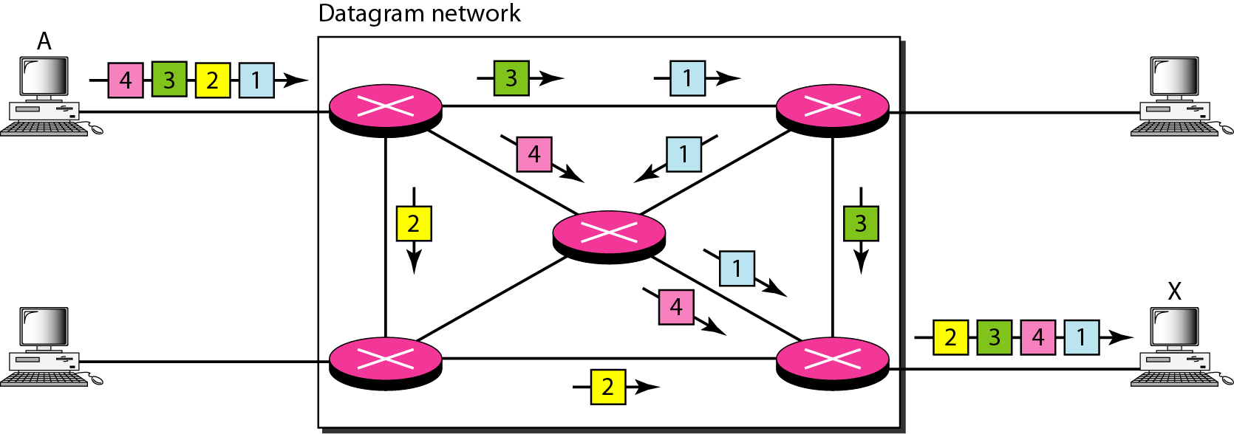
Figure 8.7 A datagram network with four switches (routers)
The switches in a datagram network are traditionally referred to as routers.

Slide 15
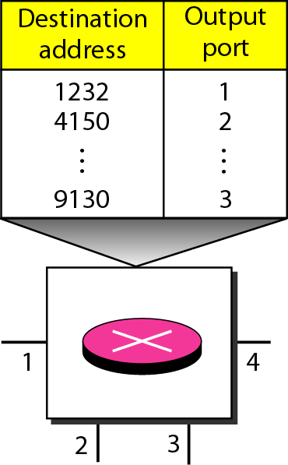
Figure 8.8 Routing table in a datagram network

Slide 16
Note
The destination address in the header of a packet in a datagram network
remains the same during the entire journey of the packet.

Slide 17
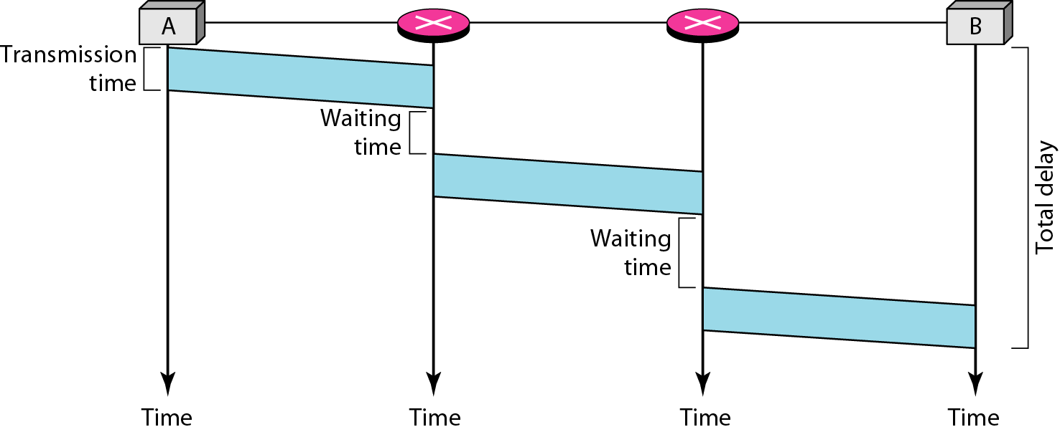
Figure 8.9 Delay in a datagram network

Slide 18
Total Delay
Transmission Delay,T
Propagation Delay,P
Waiting Time ,w_{i}
Total Delay=3T+3P+w₁ +w₂
Note : ignoring processing time in each switch

Slide 19
Virtual Circuit
Preplanned route established before any packets sent
Call request and call accept packets establish connection (handshake)
Each packet contains a virtual circuit identifier instead of destination address

Slide 20
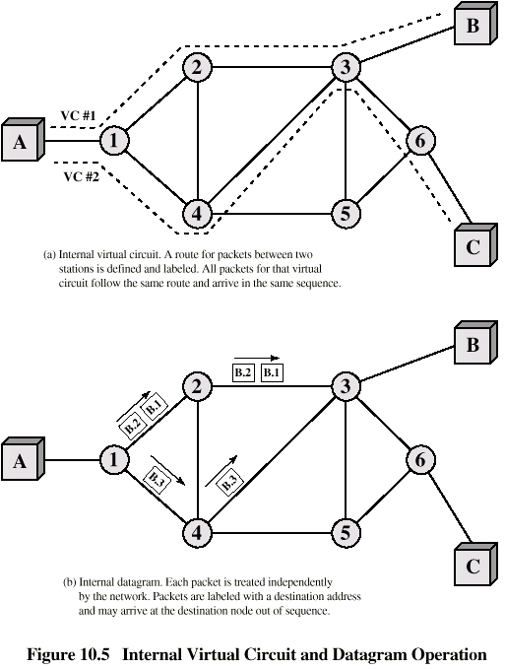
Internal Virtual Circuit and Datagram Operation

Slide 21
Note
A switch in a datagram network uses a routing table that is based on the destination address.

Slide 22
Note
Switching in the Internet is done by using the datagram approach to packet switching at the network layer.

Slide 23
8-3 VIRTUAL-CIRCUIT NETWORKS
A virtual-circuit network is a cross between a circuit-switched network and a datagram network. It has some characteristics of both.

Slide 24
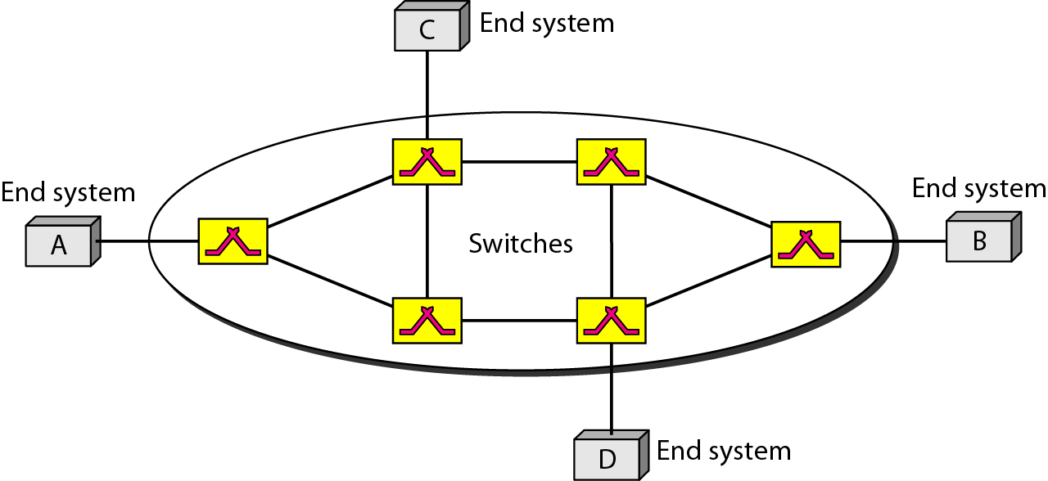
Figure 8.10 Virtual-circuit network

Slide 25
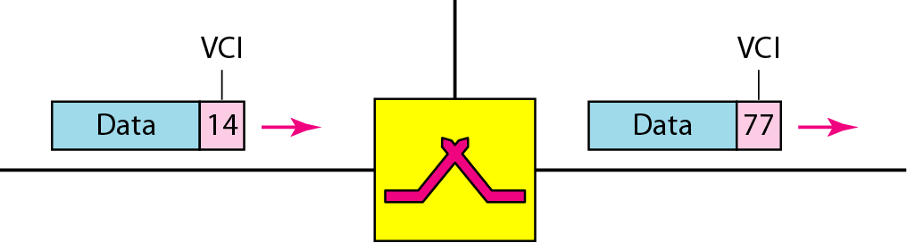
Figure 8.11 Virtual-circuit identifier

Slide 26
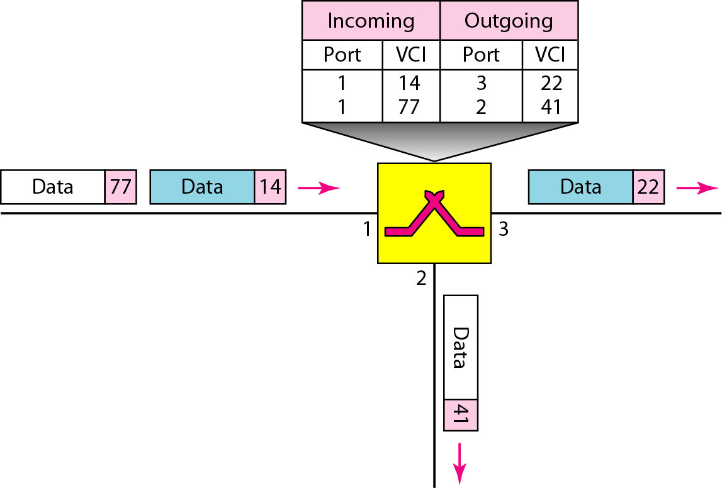
Figure 8.12 Switch and tables in a virtual-circuit network

Slide 27
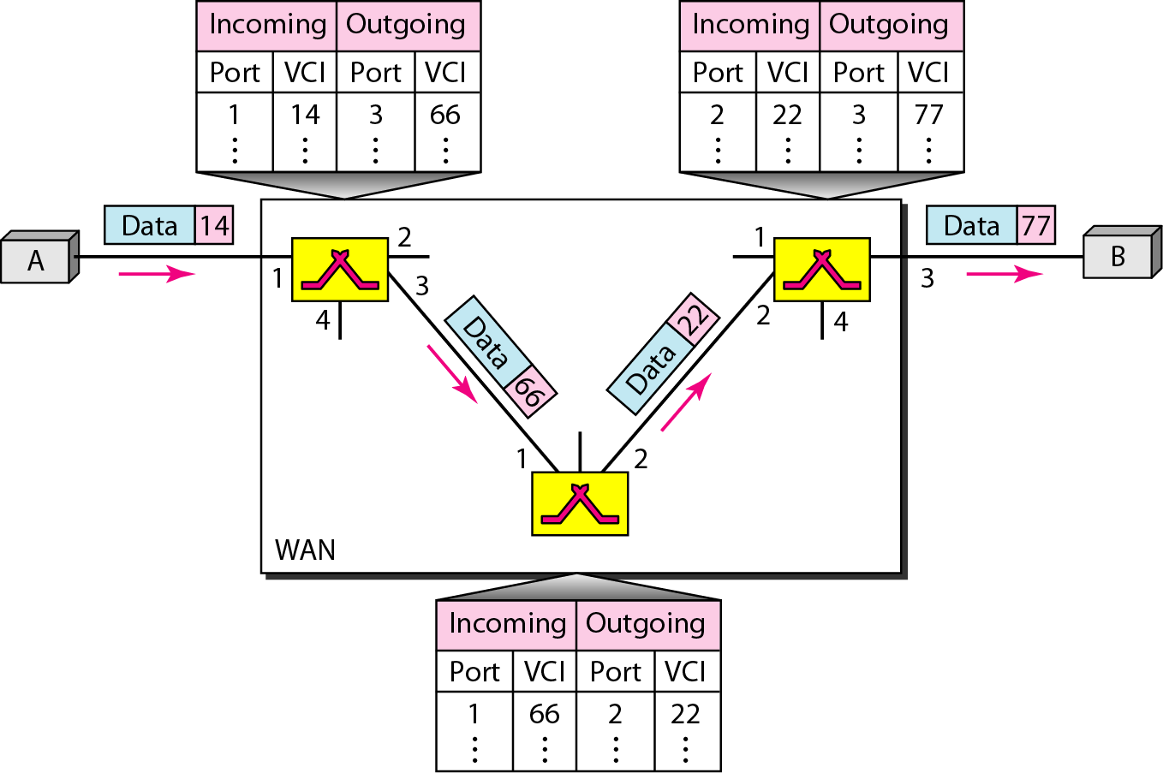
Figure 8.13 Source-to-destination data transfer in a virtual-circuit network

Slide 28
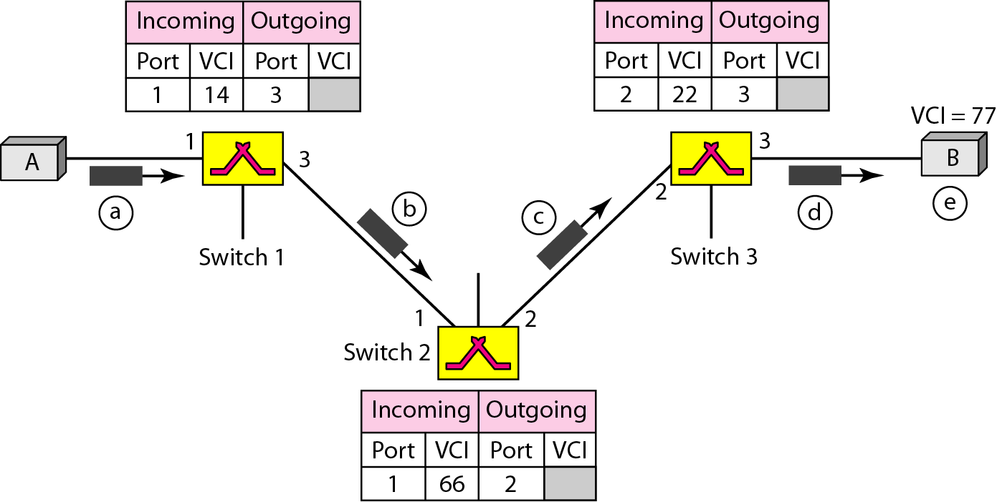
Figure 8.14 Setup request in a virtual-circuit network

Slide 29
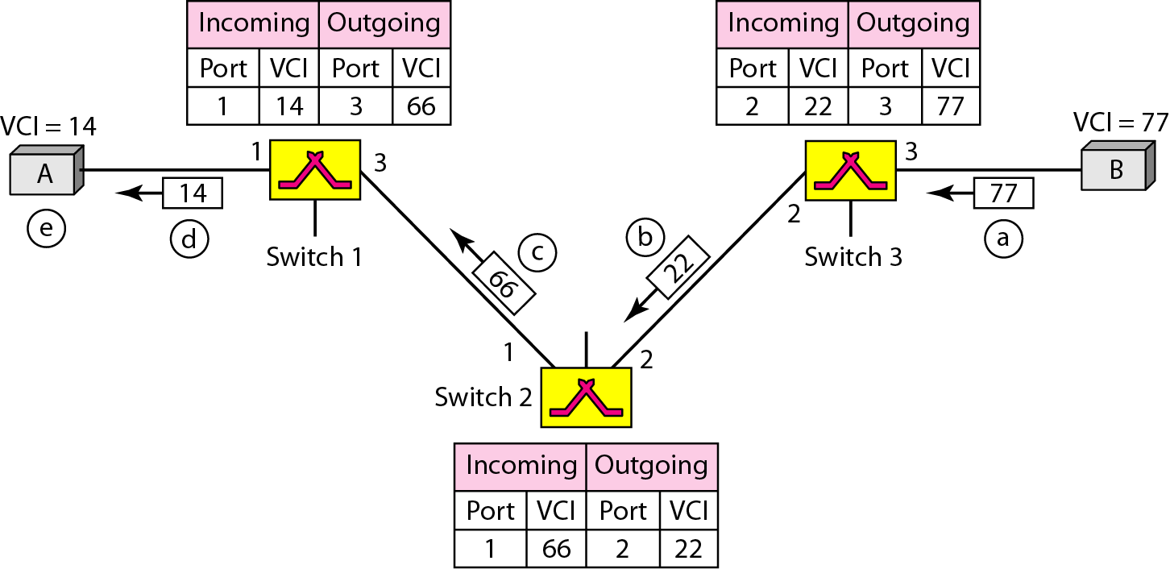
Figure 8.15 Setup acknowledgment in a virtual-circuit network

Slide 30
Note
In virtual-circuit switching, all packets belonging to the same source and destination travel the same path;
but the packets may arrive at the destination with different delays if resource allocation is on demand.

Slide 31
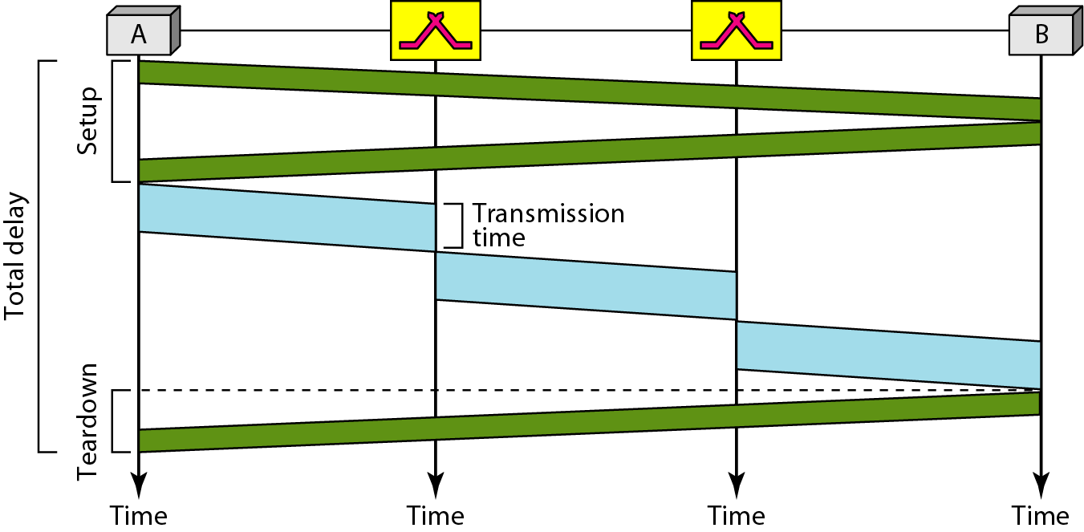
Figure 8.16 Delay in a virtual-circuit network

Slide 32
Total Delay
Transmission Delay,T
Propagation Delay,P
Total Delay=3T+3P+setup delay+ teardown delay.
Note : ignoring processing time in each switch

Slide 33
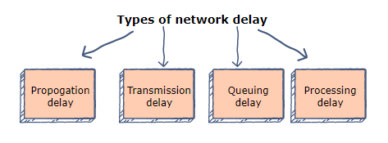
Different Types of Network Delay
Network delay refers to the amount of time it takes for a packet to go from point A to point B.
Notes:
If Point A is the source and point B is the destination, then the delay is called an end to end delay.

Slide 34

Propagation delay
The time that it takes for a bit to reach from one end of a link to the other.
The delay depends on the distance (D) between the sender and the receiver, and the propagation speed (S) of the wave signal.
It is calculated as:

Slide 35

Transmission delay
Transmission delay refers to the time it takes to transmit a data packet onto the outgoing link.
The delay is determined by the size of the packet and the capacity of the outgoing link.
If a packet consists of L bits and the link has a capacity of B bits per second, then the transmission delay is equal to:

Slide 36
Other Delays
Queuing delay
Queuing delay refers to the time that a packet waits to be processed in the buffer of a switch. The delay is dependent on the arrival rate of the incoming packets, the transmission capacity of the outgoing link, and the nature of the network’s​ traffic.
Processing delay
Processing delay is the time taken by a switch to process the packet header. The delay depends on the processing speed of the switch.

Slide 37
Solved examples
1) A is source, B is destination. A and B are separated by a distance of 48,000kms. A sends 1500 bytes to B at the rate of 100 Mbps. The signal propagates at 2.4 x 10^8 mps. Compute the propagation delay and transmission delay considering there is no other intermediate device.

Slide 38
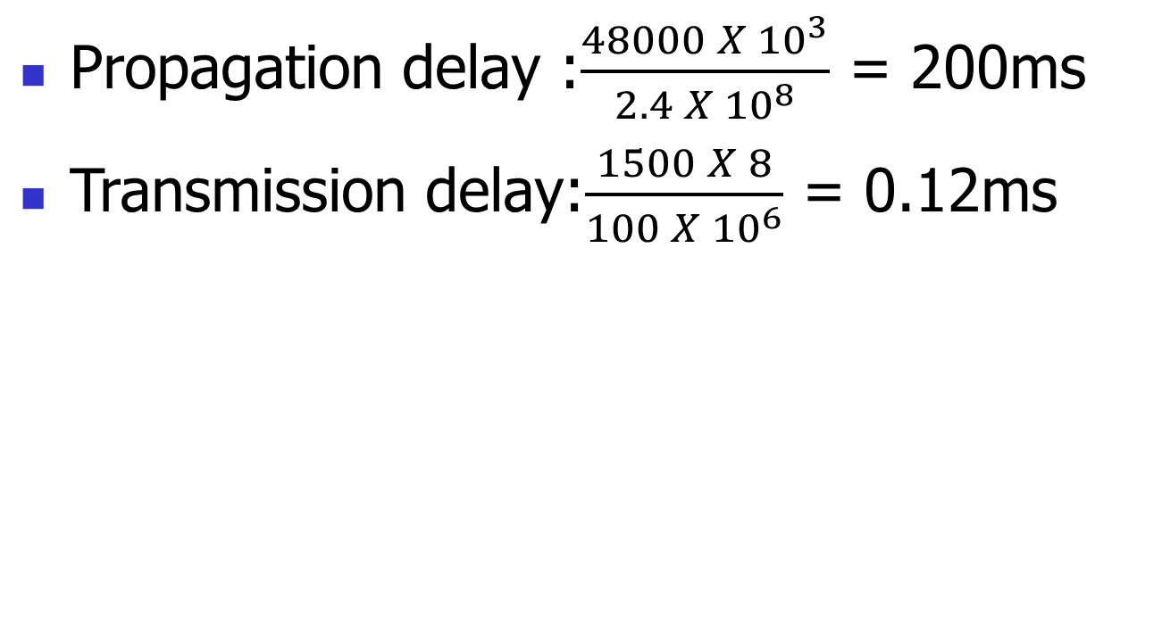

Slide 39
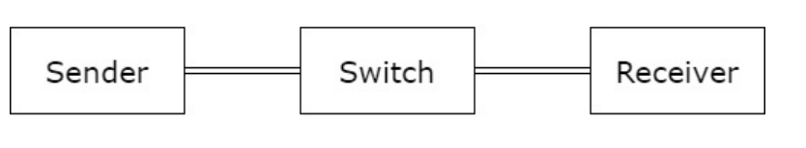
2) Sender and Receiver separated by 1Gbps link. Packet size is 5000 bits. Each link introduces a delay of 10µs. Assume switch immediately forwards the data after it receives the last bit of the packet. Ignore queuing delay. Compute the total delay

Slide 40
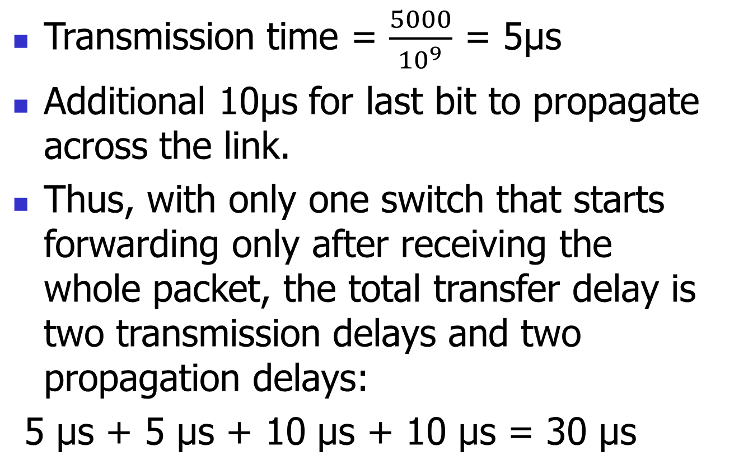
30µs

Slide 41
2B) What is the delay if the sender and receiver is separated by three switches in between?
Three switches and thus four links implies the total delay is four transmission delays and four propagation delays: 60µs

Slide 42
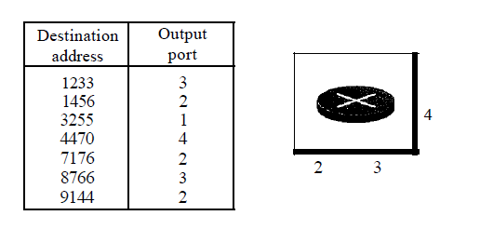
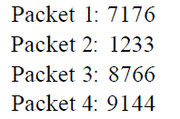
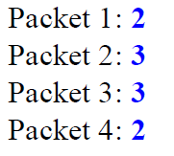
5)
Figure below shows a switch (router) in a datagram network.
Find the output port for packets with the following destination addresses:
Solution

Slide 43
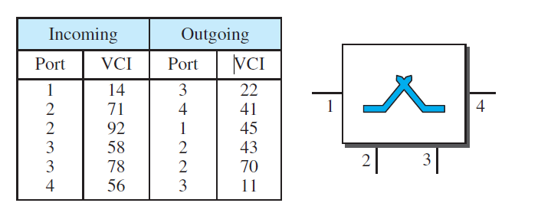
6) Figure below shows a switch in a virtual-circuit network.
Find the output port and the output VCI for packets with the following input port and input VCI addresses:
a. Packet 1: 3, 78 b. Packet 2: 2, 92
c. Packet 3: 4, 56 d. Packet 4: 2, 71
Solutions:
2,70 b. 1,45
c. 3,11 d. 4,41

Slide 44
8-4 STRUCTURE OF A SWITCH
We use switches in circuit-switched and packet-switched networks.
Discuss the structures of the switches used in each type of network.

Slide 45
Structure of Circuit Switches
Circuit Switching uses either of two technologies
Space-Division Switch
Time-Division Switch
Notes:
Space-Division Switch: paths in the circuit are separated from each other spatially.

Slide 46
Space-Division Switch
single transmission path is accomplished in a switch by using a physically separate set of crosspoints.
Crossbar Switch
Multistage Switch

Slide 47
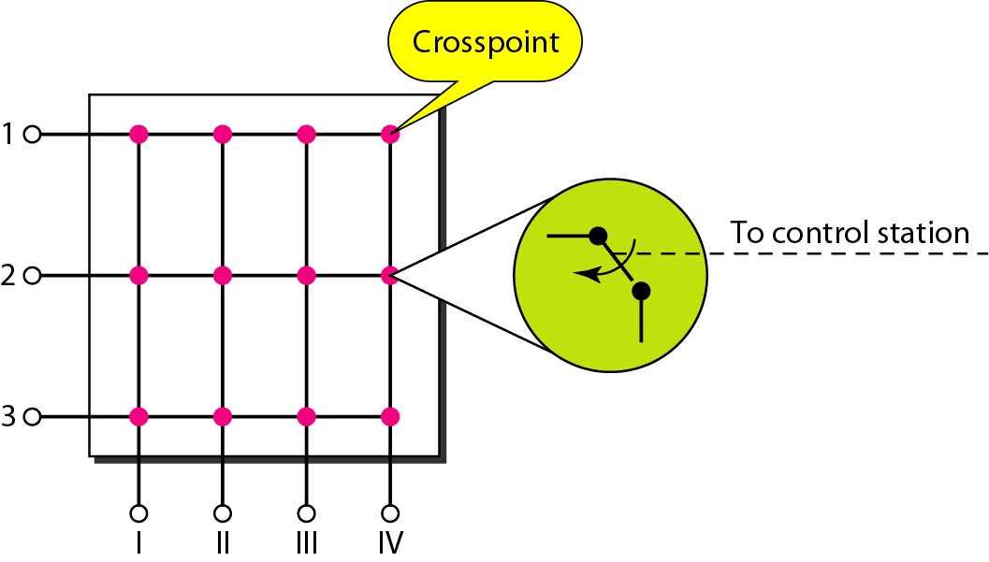
Figure 8.17 Crossbar switch with three inputs and four outputs
Notes:
N input is connected m output using elctronic micro switches at crosspoint.
Major limitation to add a new port, number of crosspints required is very high.
Adv
Non blocking
At a time only one connection or path is active
N*m crosspints=1000*1000 requires switch with 1000000 crosspint.
Such a switch is inefficient because fewer than 25% of crosspints are in use, at any given time.

Slide 48
Crossbar - example
sessions: (1,2) (2,4) (3,1) (4,3)
1
2
3
4
1
2
3
4

Slide 49
Crossbar - example
1
2
3
4
1
2
3
4

Slide 50
Crossbar
Advantages:
simple to implement
simple control
strict sense non-blocking
Drawbacks
number of crosspoints, N²
large VLSI space
vulnerable to single faults

Slide 51
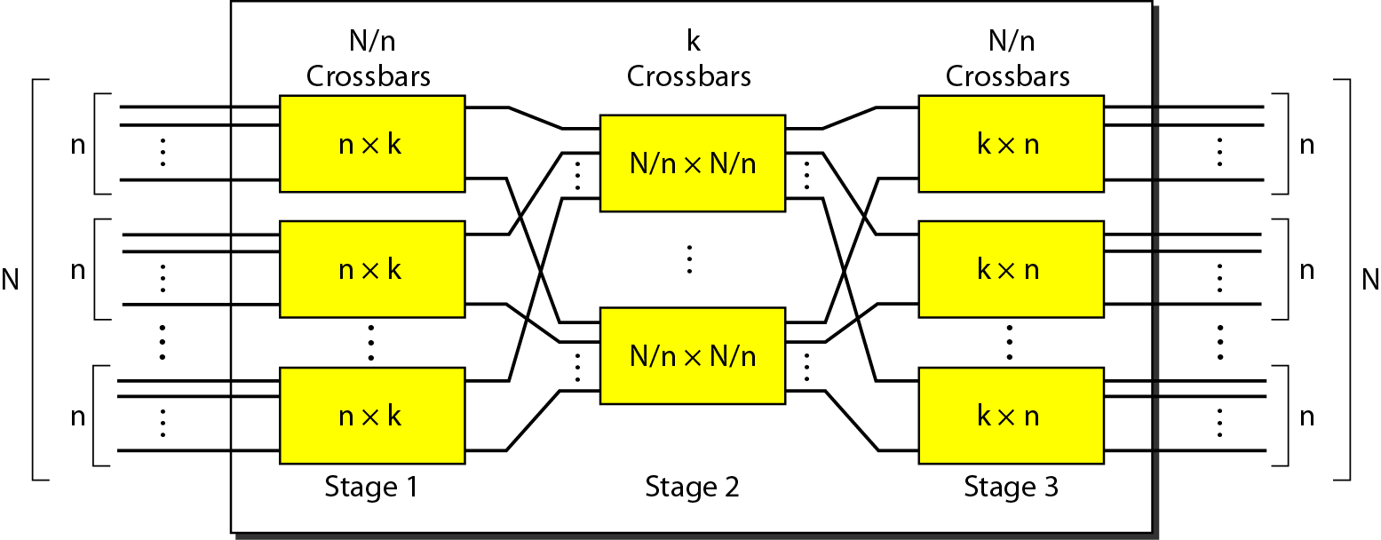
Figure 8.18 Multistage switch

Slide 52
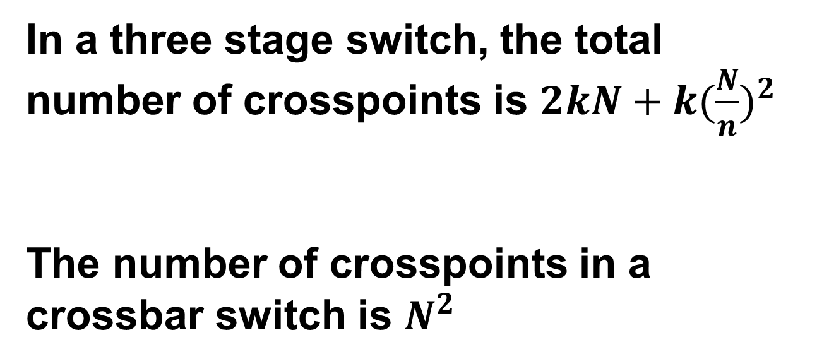

Slide 53
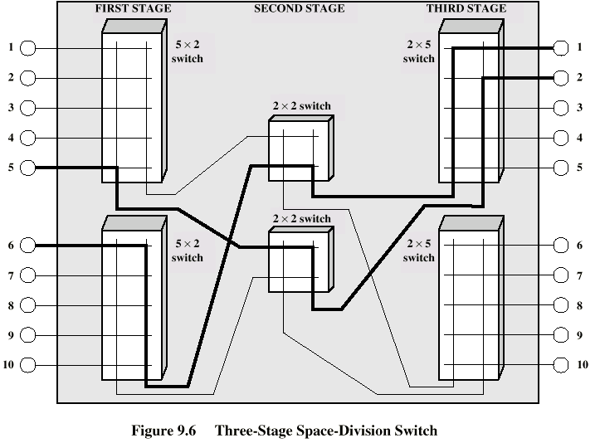
Three Stage Switch

Slide 54
Problems
Design a three-stage, 200 × 200 switch (N = 200) with k = 4 and n = 20.

Slide 55
Problems
Design a three-stage, 200 × 200 switch (N = 200) with k = 4 and n = 20.
Solution
first stage we have N/n or 10 crossbars, each of size 20 × 4. In the second stage, we have
4 crossbars, each of size 10 × 10. In the third stage, we have 10 crossbars, each of size 4 × 20.

Slide 56
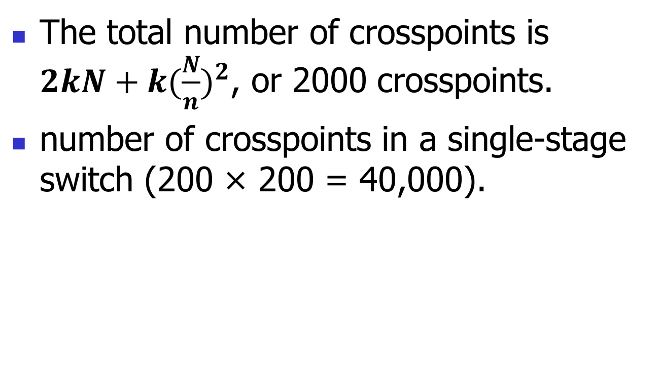
Sol conti.

Slide 57
Drawback
one drawback—blocking during periods of heavy traffic.
Blocking refers to times when one input cannot be connected to an output.
Notes:
Blocking refers to times when one input cannot be connected to an output because there is no path available between
them—all the possible intermediate switches are occupied.
The whole idea of multistage switching is to share the crosspoints in
the middle-stage crossbars. Sharing can cause a lack of availability if the resources are
limited and all users want a connection at the same time

Slide 58
Non Blocking Condition
Clos investigated the condition of nonblocking in multistage switches.
In nonblocking switching fabric, the number of middle-stage switches must be at least 2n – 1.
In other words, we need to have k ≥ 2n – 1.

Slide 59

Clos Criteria
Activity:
Redesign the previous three-stage, 200 × 200 switch, using the Clos criteria with a minimum number of crosspoints. Calculate the number of crosspoints.

Slide 60
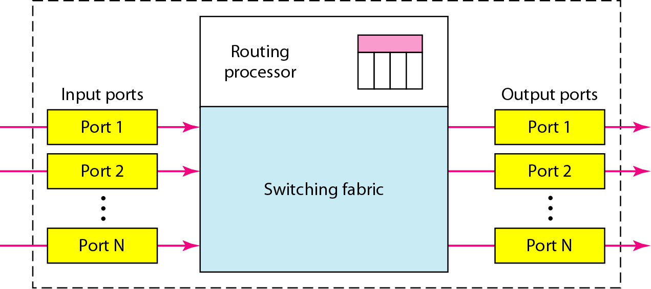
Figure 8.21 Packet switch components
4 components

Slide 61
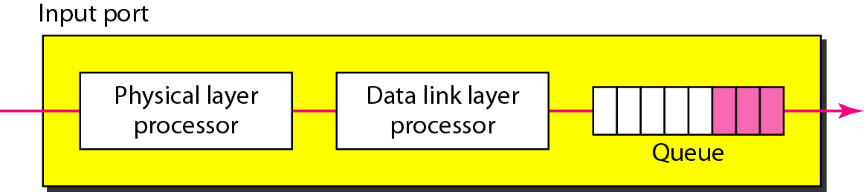
Figure 8.22 Schematic diagram of an Input port
Error detection

Slide 62
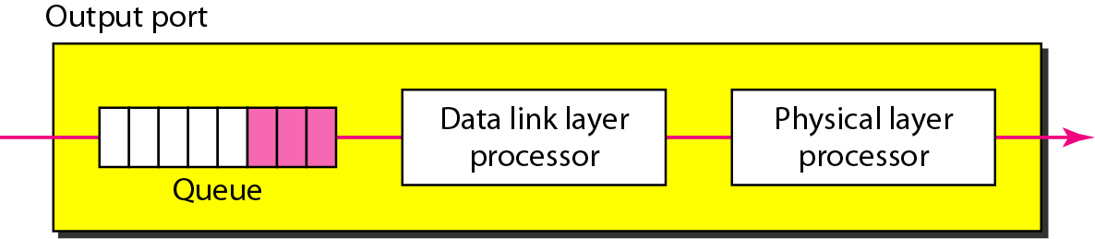
Figure 8.23 Output port
Routing processor performs table lookup
Switching fabric redirects packets from input queue to output queue.
The simplest type of switching fabric is the crossbar switch.

Slide 63
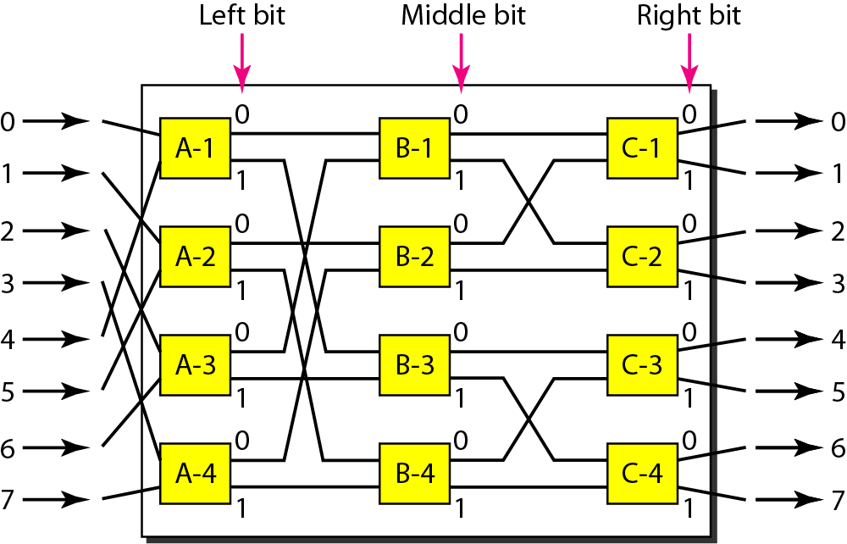
Figure 8.24 A banyan switch

Slide 64
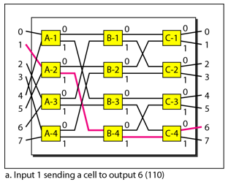
Figure 8.25 Examples of routing in a banyan switch

Slide 65
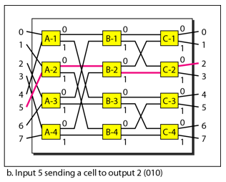
Figure 8.25 Examples of routing in a banyan switch

Slide 66
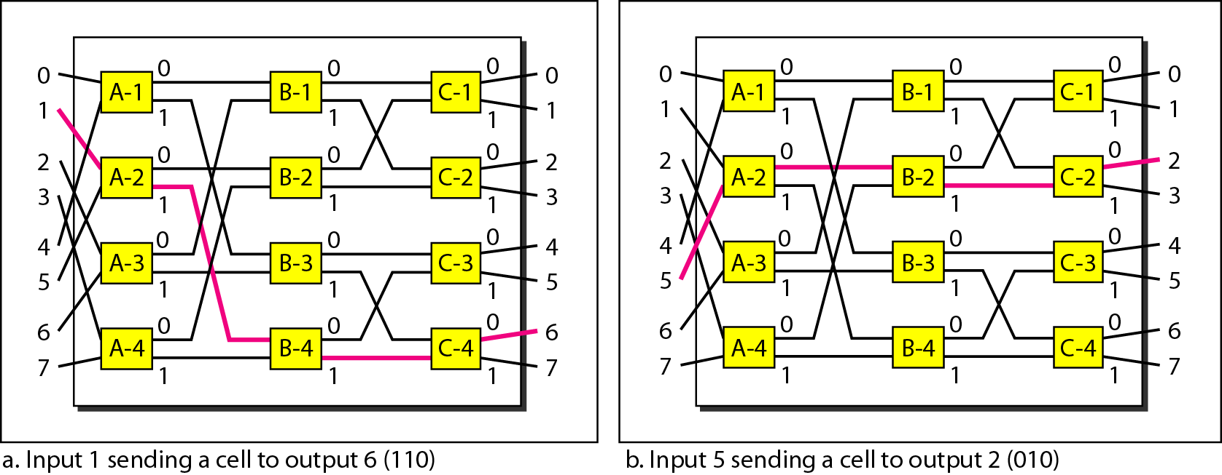
Figure 8.25 Examples of routing in a banyan switch

Slide 67
Performance Measures for a Switch
Connectivity (e.g., blocking probability): Set of pairs of input and output links that can be simultaneously connected through the switch
Delay (Queuing)
Setup time (used mostly in circuit switching)
Throughput (number of ports, and speed of every port)

Slide 68
Complexity, in terms of:
Number of cross points
Size of buffers
Speed of the switch bus (internal speed)

Slide 69
In Summary
What are the differences between a circuit switched network and a packet switched network?
What is a non-blocking switch/network?
What are the differences between datagram packet switched and virtual circuit packet switched?
What are the differences between a circuit switch and a packet switch?

Slide 70
Additional information:
https://www.javatpoint.com/computer-network-switching-techniques

Slide 71

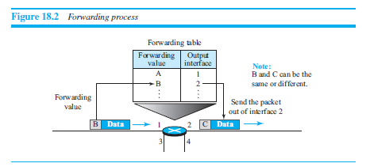
Packetizing
Routing and Forwarding

Slide 72
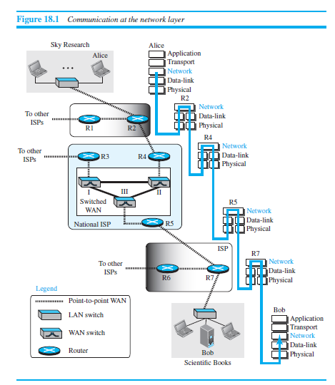

Slide 73
Packetizing
Routing and Forwarding
Other Services
Error Control
Flow Control
Congestion Control
Quality of Service.
Security

Slide 74
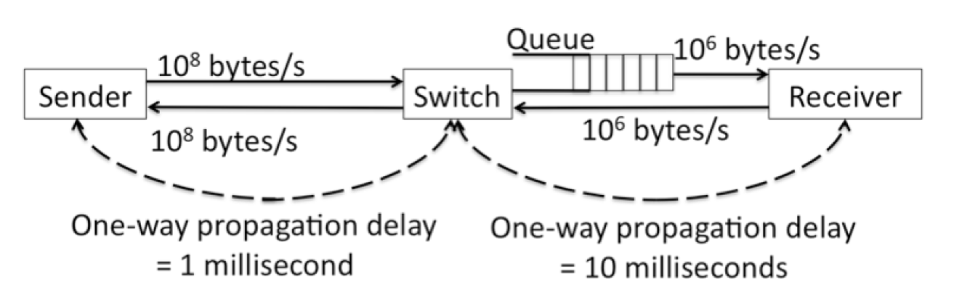
3) Consider the network topology shown below. Assume that the processing delay at all the nodes is negligible.
The sender sends two 1000-byte data packets back-to-back with a negligible inter-packet delay. The queue has no other packets.
What is the time delay between the arrival of the first bit of the second packet and the first bit of the first packet at the receiver?

Slide 75
After the first bit of the first packet arrives at the receiver, it will take 1 millisecond for the rest of the packet to arrive (1000 bytes at 1 million bytes/sec).
Since the connection from the sender is much faster than the connection to the receiver, the second packet arrives in the queue before the first packet has been completely sent to the receiver. That means that the first bit of the second packet is available for sending right after the last bit of the first packet.
So the total delay is 1 ms.

Slide 76
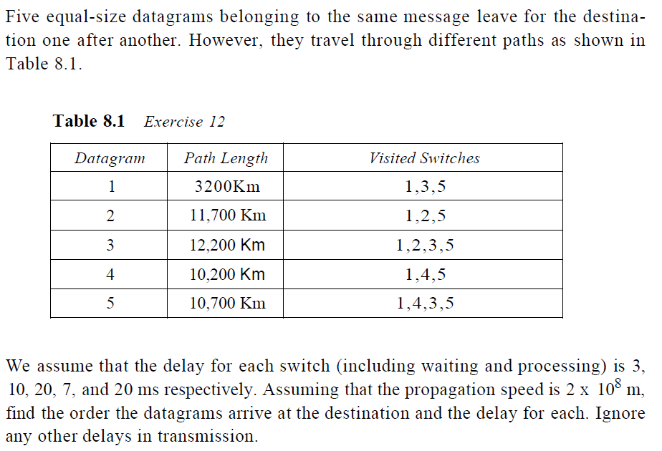
4)

Slide 77
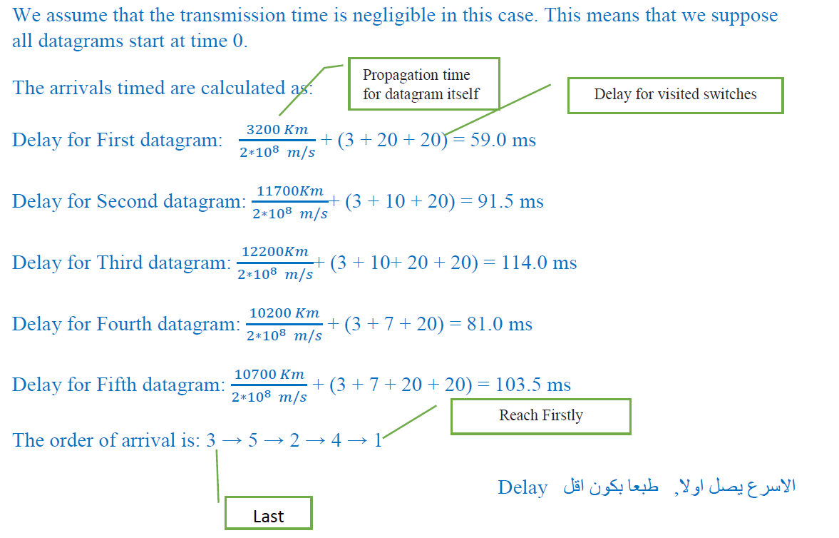

Slide 78
We need a three-stage space-division switch with N = 100. We use 10 crossbars at the first and third stages and 6 crossbars at the middle stage.
a. Draw the configuration diagram.
b. Calculate the total number of crosspoints.
c. Find the possible number of simultaneous connections.
d. Find the possible number of simultaneous connections if we use a single- crossbar (100 ⋅ 100).
e. Find the blocking factor, the ratio of the number of connections in part c and in part d.

Slide 79
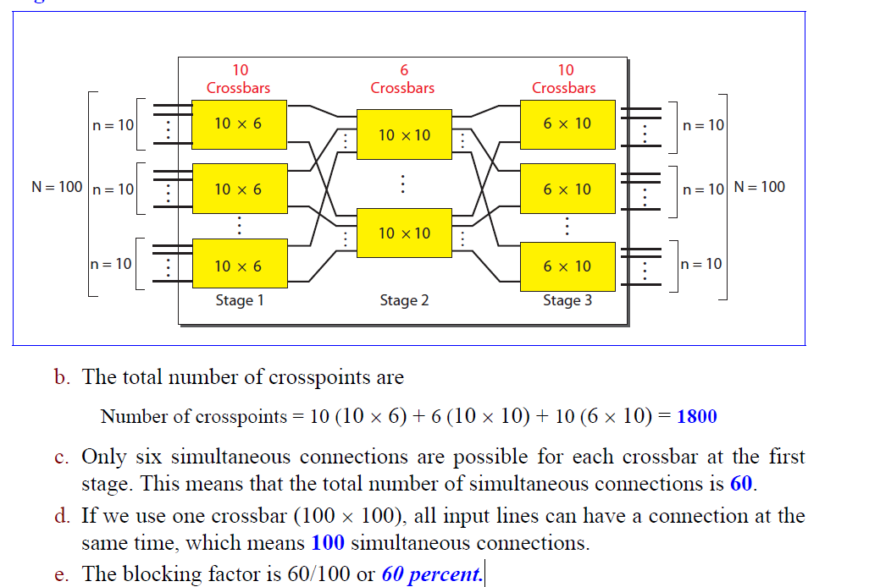

Slide 80
We need a three-stage space-division switch with N = 15 . We use 3 crossbars at the first and third stages and 2 crossbars at the middle stage.
a. Draw the configuration diagram.
b. Calculate the total number of crosspoints.
c. Find the possible number of simultaneous connections.
d. Find the possible number of simultaneous connections if we use a single- crossbar (15 ⋅ 15).
e. Find the blocking factor, the ratio of the number of connections in part c and in part d.

Slide 81
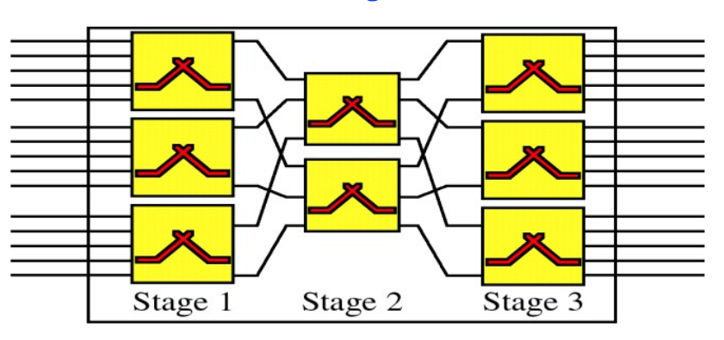
We need a three-stage space-division switch with N = 15 . We use 3 crossbars at the first and third stages and 2 crossbars at the middle stage.
a. Draw the configuration diagram.
b. Calculate the total number of crosspoints= 78
c. Find the possible number of simultaneous connections= 6
d. Find the possible number of simultaneous connections if we use a single- crossbar (15 ⋅ 15).= 15
e. Find the blocking factor, the ratio of the number of connections in part c and in part d.= 40%

Slide 82
Question
We need to have a space-division switch with 200 inputs and outputs. What is the total number of crosspoints and number of simultaneous connections in each of the following cases?
a. Using one single crossbar.
b. Using a multi-stage switch.
c. Using a multi-stage switch based on the Clos criteria
Notes:
1st =59+tfr
2nd =91.5+tfr
3rd=140
4th=81
5th =103.5
Order → 1,4,2,5,3

Slide 83
Question
A path in a digital circuit-switched network has a data rate of I Mbps. The exchange of 1000 bits is required for the setup and teardown phases. The distance between two parties is 5000 km. Answer the following questions if the propagation speed is 2 X 10⁸ m:
a. What is the total delay if 1000 bits of data are exchanged during the data transfer phase?
b. What is the total delay if 100,000 bits of data are exchanged during the data
transfer phase?
Notes:
1st =59+tfr
2nd =91.5+tfr
3rd=140
4th=81
5th =103.5
Order → 1,4,2,5,3

